Slide 1
Twin Lakes Swim Team
Kick Off
April 23, 2023
WELCOME

Slide 2
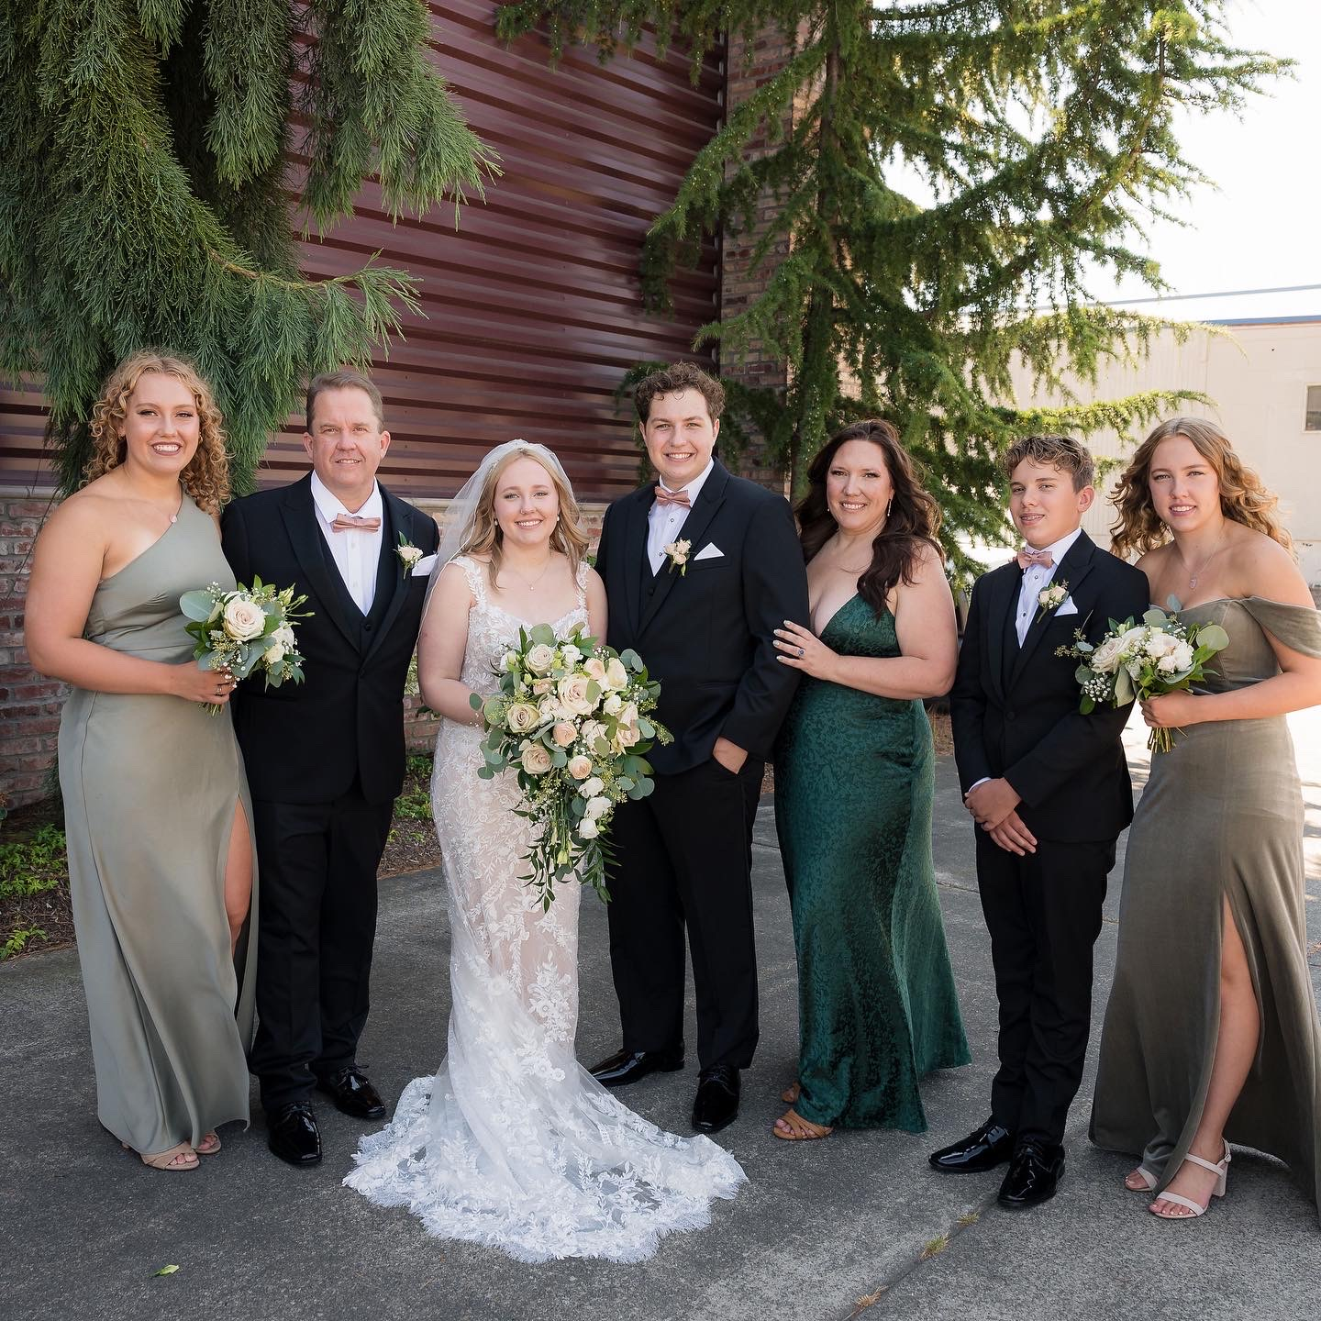
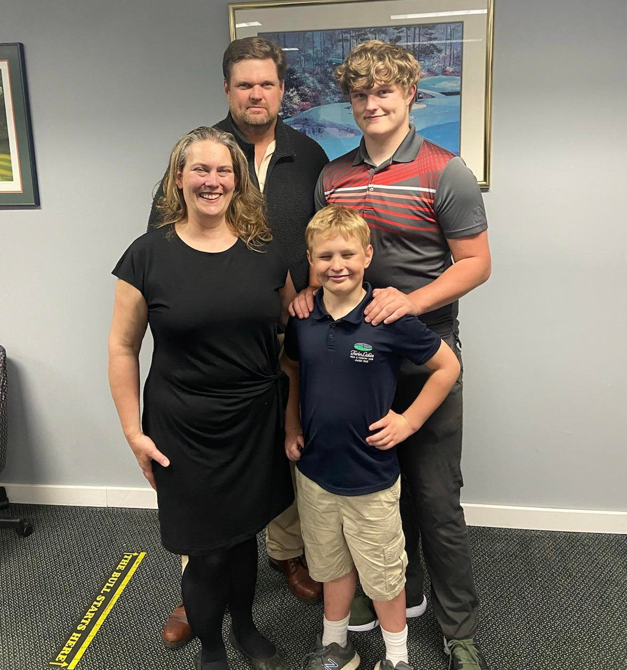
Your Swim Team Managers
Charis Tucker
Julie Sharples

Slide 3
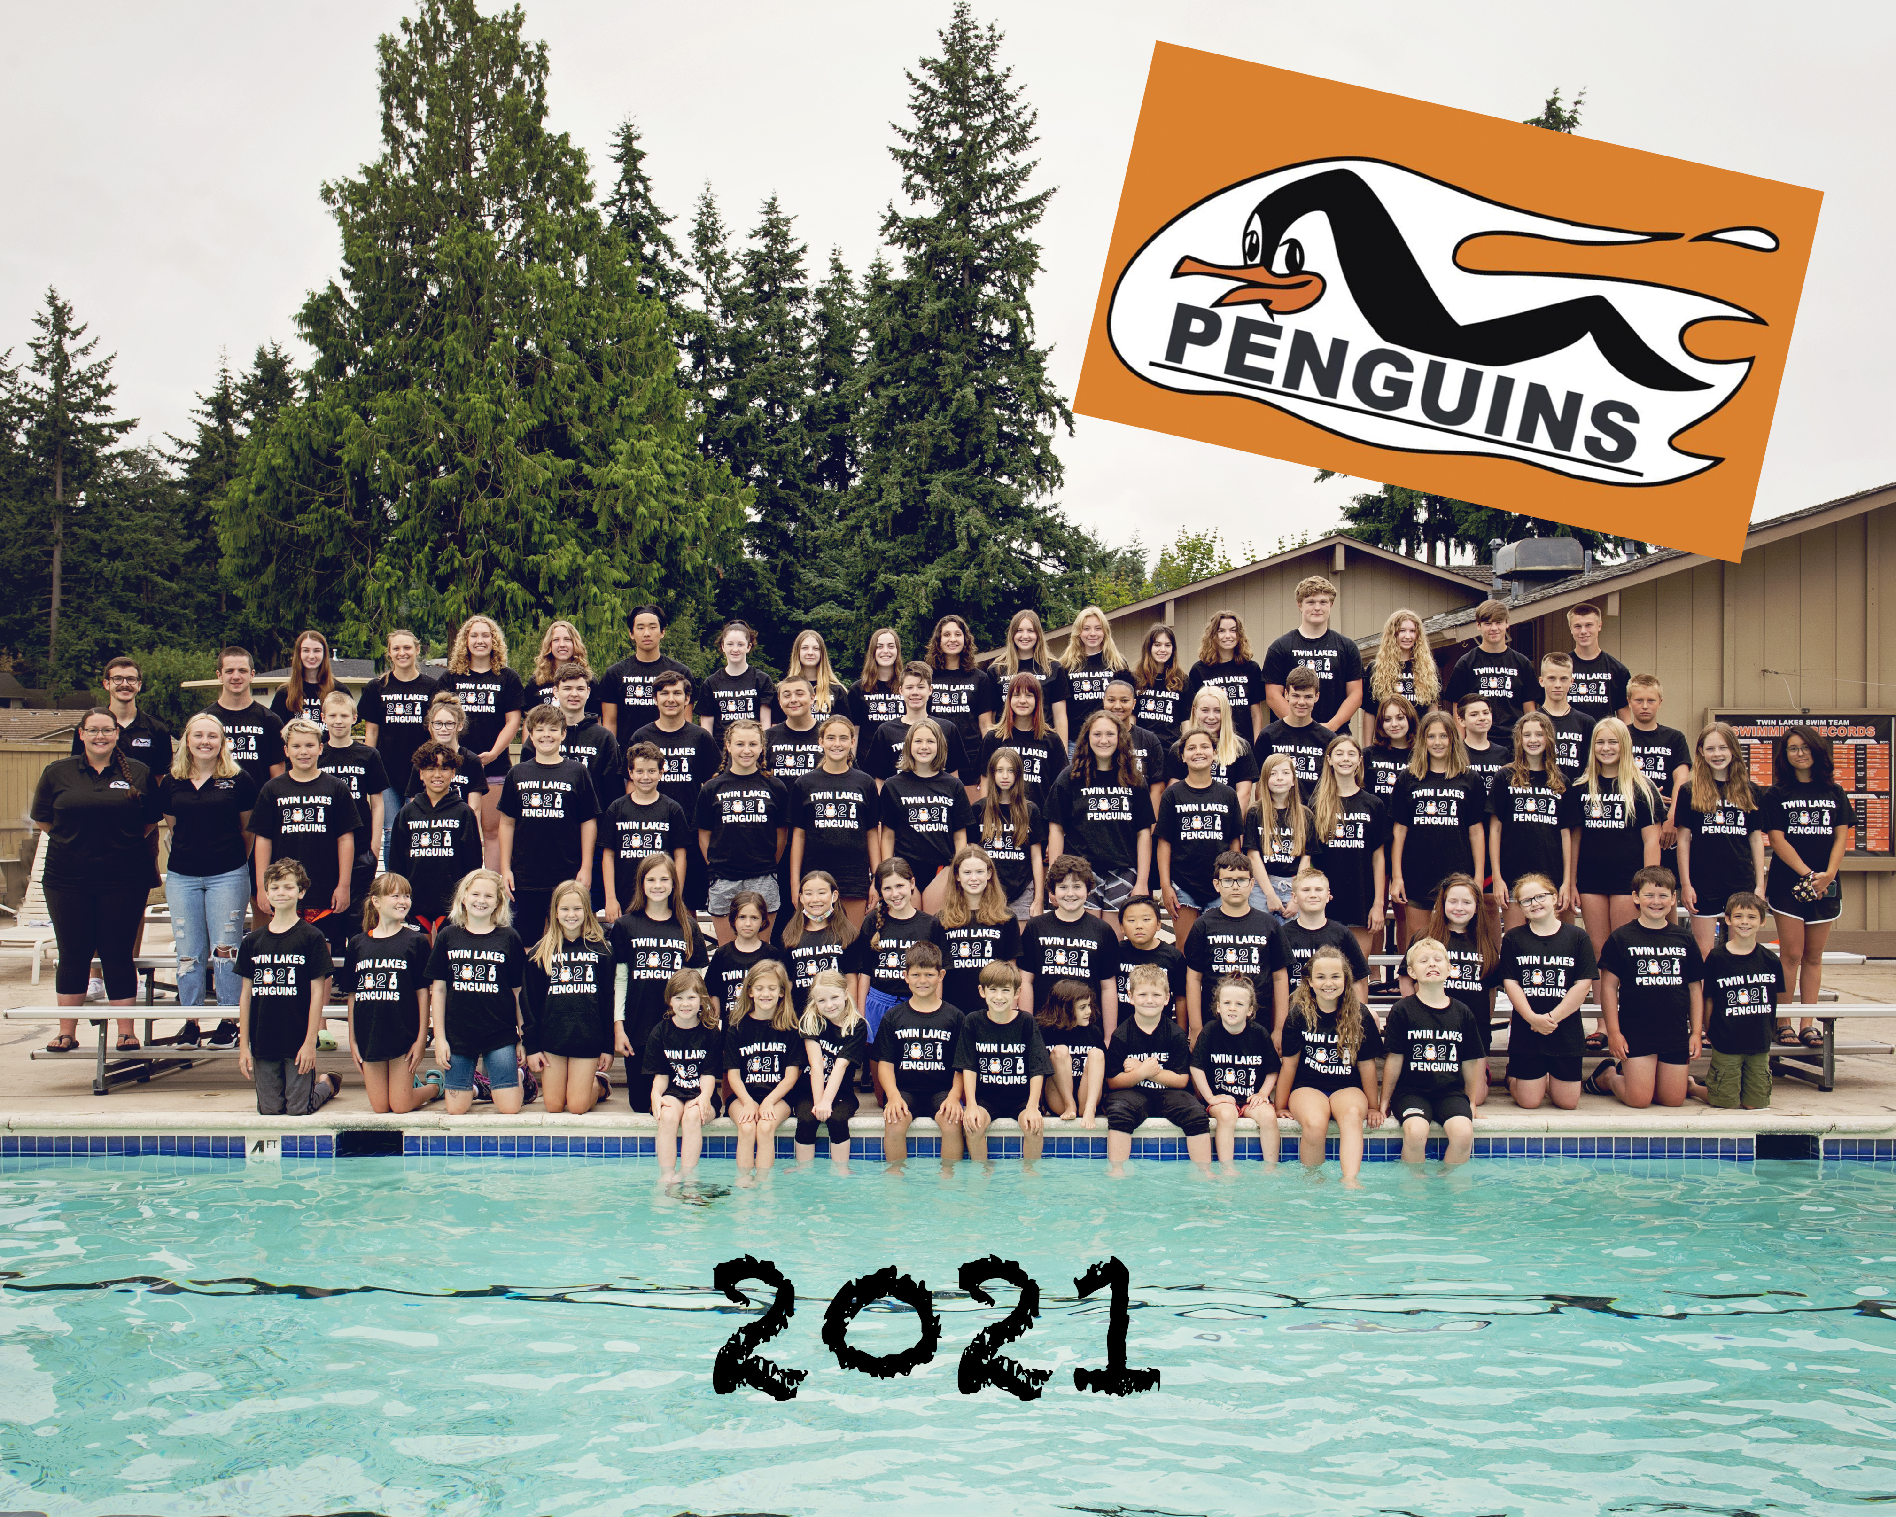
Welcome Penguin families and prospective
Penguin families!
Thank you for coming to learn more about our team and the upcoming 2023 season.
What is Twin Lakes Swim Team all about?
We are a summer league swim team for ages 5 – 18 that focuses on developing each swimmer to their full potential.
We help each swimmer increase their endurance, strength, stroke technique, starts, turns and overall love for swimming in a safe, and FUN environment.

Slide 4
2023 Season
June 20- Parent Kid Meet
June 28- Olympic View @ TL
June 27- TL @ Arbor Heights
June 29- Normandy Park @ TL
July 6 - Lakeridge @ TL
July 11 – TL @ Gregory Seahurst
July 13- Kent @ TL
July 18 - TL @ Marine Hills
July 20 - B Champs @ Arbor Heights
July 24- Girls Prelims @ Gregory Seahurst
July 25- Boys Prelims @ Olympic View
July 27 – Southerns @ Arbor Heights
August 1 – All City @ Aqua Club

Slide 5
Volunteers
Volunteers are needed to host successful swim meets!
Expectation is that EACH family will fill at least one volunteer position at EACH home meet.
Thank you to our Volunteer Coordinators
Sponsorship Coordinator – David Goretski
Pancake Breakfast Organizer- Amy Dill - July 20th
Big Buddy Coordinator- Thank you Charis Tucker
New Parent welcome – Leila Carlson and Lisa Yalcin
Volunteer Coordinator – Dannylle Labrec
Computer Lead – Michael Gintz

Slide 6
We are still in need of Several Lead Volunteers
Eligibility Officer – determines eligibility of any non binary or transgender swimmers
Set up group – need approximately 4 parents for each home meet
Additional Big Buddy parent to help shadow
Additional fundraising committee members
Tear down group – Approximately 4 parents to help tear down after each home meet
Senior Night Parent – collect photos and put together senior night presentations
Awards Banquet / Sleepover – help organize and acquire supplies

Slide 7
What can I do to help?
Volunteer positions for each meet:
Timers (first half, second half, and head)
Runners
Awards
Announcer
Officials
Computer – Assist Michael Gintz and Shadow
Other team events (ie. Pancake Breakfast, Banquet, Sleepover)
Post-season
Timers
Officials

Slide 8
Getting in shape for
summer league!
Pools are open! Most require sign-ups for lap swim, contact your facility of choice to inquire on their specific procedures. Cross training and dryland workouts are always helpful as well! You don’t even have to do anything formal – go for a walk or a jog, do some body weight exercises such as push-ups or squats, go for a bike ride, just do what you can do to move your body.
Some of the area teams also offer specials for swimmers to enroll and get ready for summer season
Our coaches will also be publishing swim workouts and dryland workouts for swimmers to use before the season starts.
Ask for contact info for private lessons. We know of some amazing instructors who will be able to start lessons in May or even earlier

Slide 9
Social Events for 2023
Parent vs. Kids Swim Meet- June 20th
Pancake Breakfast- July 20th
Banquet/Sleepover- August 2nd.
TBD – sign making parties
Mark your calendar!!

Slide 10
2023 Team
Swimsuits

Slide 11
All swimsuits and gear can now be ordered through
SwimOutlet.com
Penguins Shop and sent directly to YOU!
www.swimoutlet.com/twinlakespenguins

Slide 12
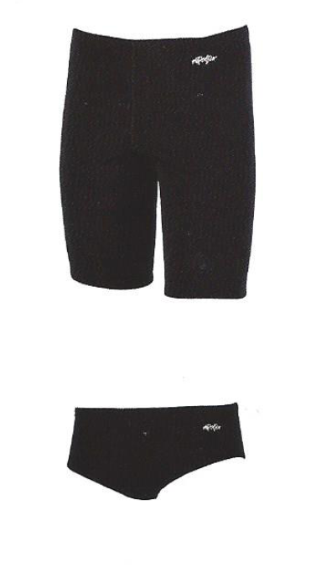
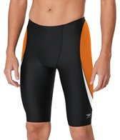
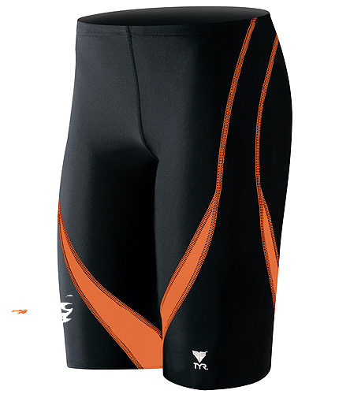
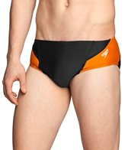
www.swimoutlet.com/twinlakespenguins
Boys Swimsuits
Multiple styles and price ranges to choose from:
TYR orange splice jammer
Dolphin black jammer
Sporti black piped splice brief
Sport solid black brief
Prices range from $21 - $48 for the suits, and the prices due tend to fluctuate a bit on the website.
There are also several black and orange options under swim wear and gear
*Please note that custom orders take several weeks, please order early.

Slide 13
www.swimoutlet.com/twinlakespenguins
Girls Swimsuits
Sporti Solids
Multiple styles and price ranges to choose from:
Sporti solid black thick or thin straps
Many of our older girls also opt for the Perry Sunkist contrast Jolyn, can be bought directly from jolyn.com . Please no tiebacks
There are also an assortment of black and orange suits in the swim wear and gear category
Prices range from $30 - $75 for the suits, and the prices do tend to fluctuate a bit on the website.

Slide 14
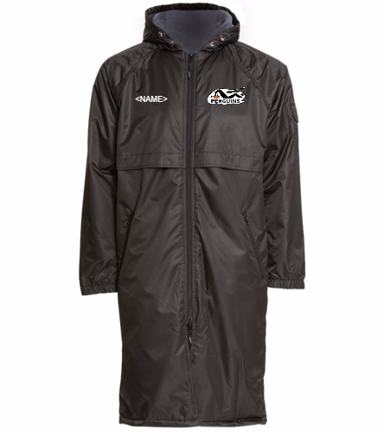
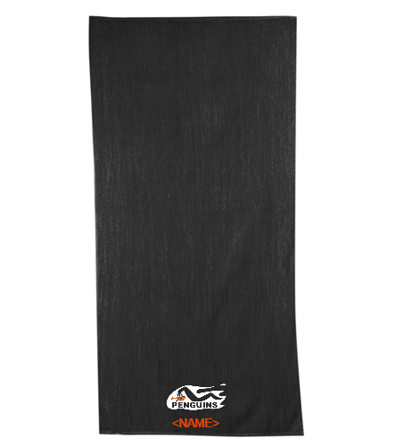
Other Gear:
Towels
Parka
Tote
Backpack
Hat
Goggles

Slide 15
2023 Swimmer & Parent
T-Shirts

Slide 16
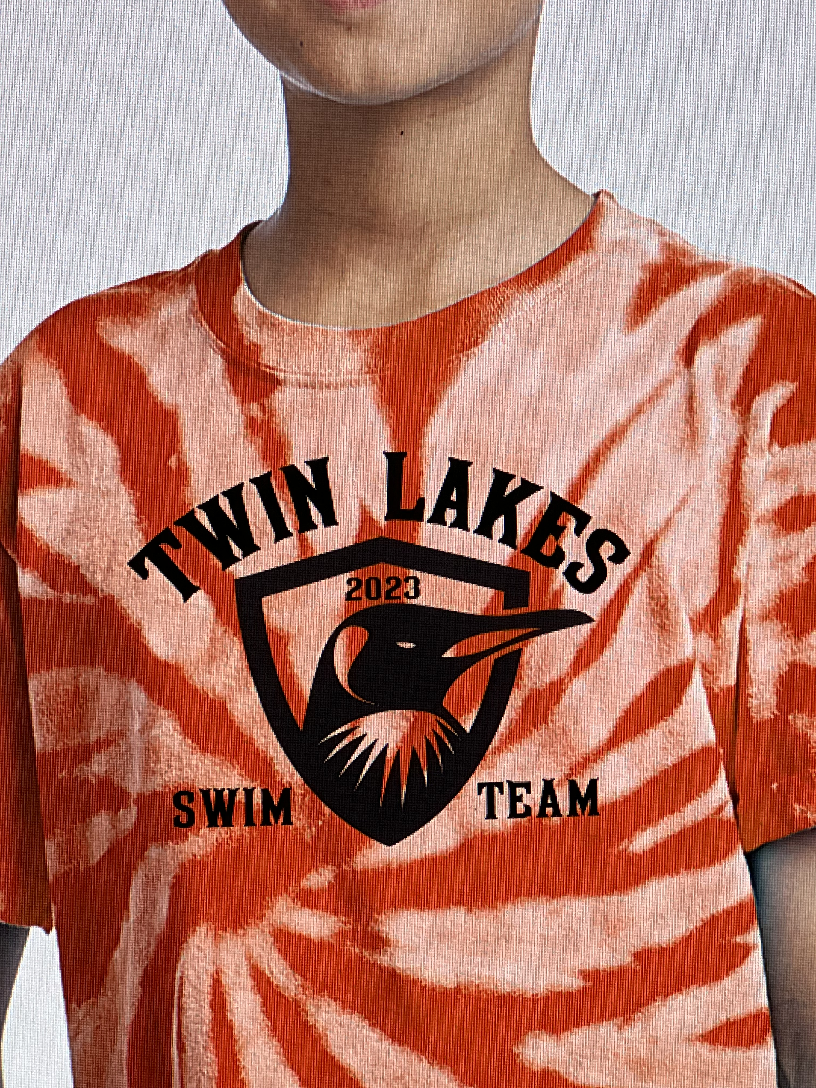
Swimmer and Parent T-Shirts
Each swimmer gets a T-shirt AND orange silicone swim cap with their registration fee and you will specify your T-shirt size when you sign up online at www.twinlakespenguins.com
T-shirts are available in Youth Small, Medium, Large and
Adult Small, Medium, Large and X-Large.
Order forms are online for additional shirts.
Team T-Shirts

Slide 17
Additional Penguin Shirts
This year we are happy to offer new styles and an ability to pay with credit card!
You can order:
T-shirts
Women’s cut tees (crew or v-neck)
Tank Tops
Long sleeve t-shirts
Baseball Ts
Hooded Pullover Sweatshirts
Full Zip Hooded Sweatshirts
Order forms will be on our website. You can pay via check (made out to Craig and Linda’s Embroidery) or credit card by filling out the necessary info on the order form
T-shirts and caps will be handed out at practices or during Junior Golf sign ups on June 3rd.

Slide 18
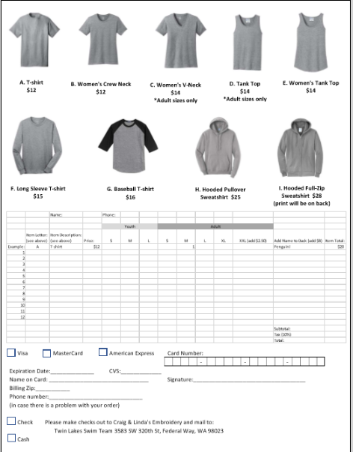
2021 Apparel Order Form

Slide 19
Twin Lakes Coaches 2023

Slide 20
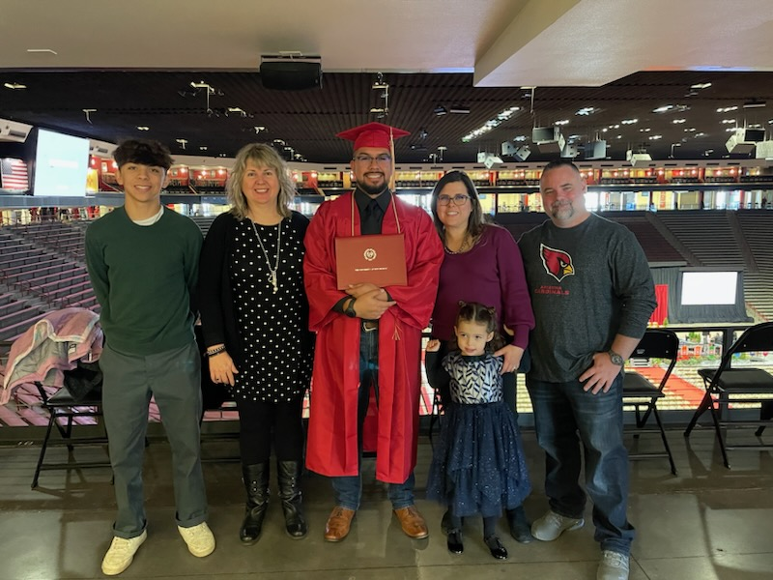
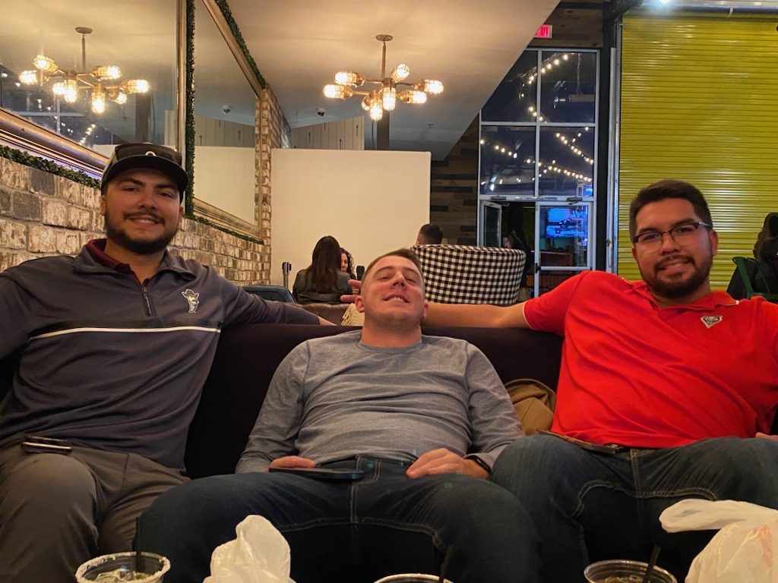
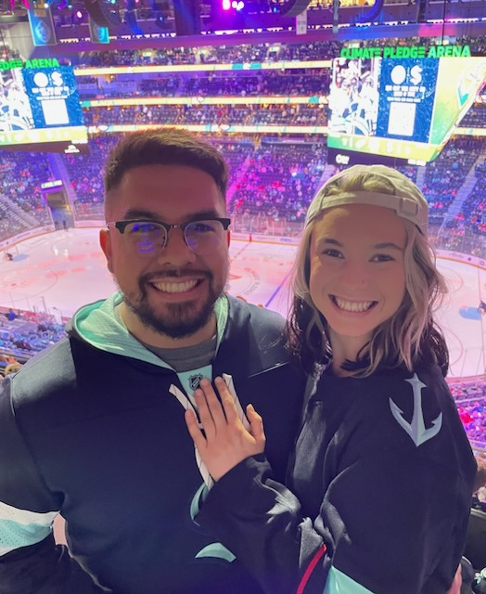
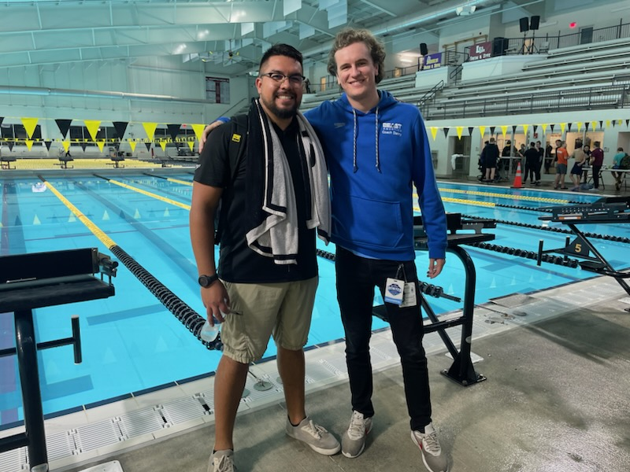
Head Coach – Sebastian Fidalgo
Hey Penguins! My name is Sebastian and I’m very excited to be coaching y’all this year. I’m from New Mexico and I swam competitively for almost 10 years! After high school I started coaching a team in New Mexico and have now been coaching for almost 4 years. I have coached at every level from novice groups to junior nationals. I’m very excited to be working with y’all this summer! Fun Fact about me: I
am a citizen of 3 different countries!
Lets Go Penguins!

Slide 21
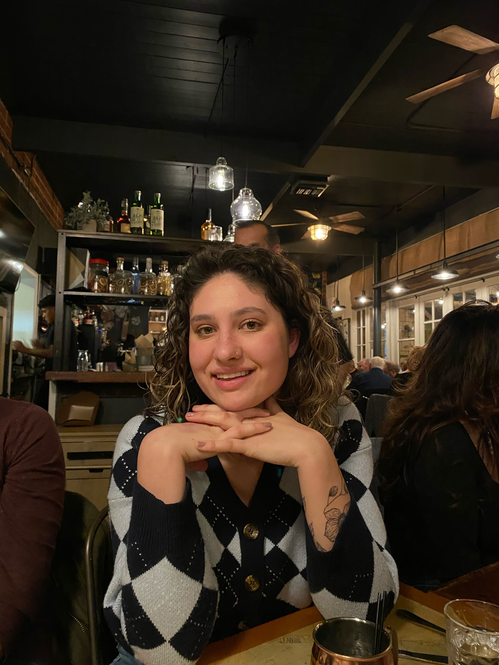
Assistant Coach - Madilyn murphy
Hey penguins! I am back! Im so excited to be coaching another year! A little bit about me, Im going into my junior year of college and studying human development with a minor in criminal justice. I will be studying criminal justice in Florence Italy this next semester! I swam for the penguins 9 years! But have been swimming for 12. I am excited to be working with these awesome coaches and you guys!!
Go penguins!!

Slide 22
Speedy Sixer Coach
Are you (or someone you know) interested in being our speedy sixer coach? Accepting applications from those 16 and up who want to work with our littlest penguins, and are willing to get wet!

Slide 23
Twin Lakes Club Memberships 2023

Slide 24
Twin Lakes Country Club Memberships
Summer Membership - $550 which includes
Use of the Pool Facility
Use of Tennis Court
Access To Restaurant & Lounge
No Initiation Fee for new members this year!

Slide 25
Contact David Hobson for membership
Social Membership $90.00 / month + tax
$120.00 / quarterly food purchase
$10.00 / month facility fee
Use of Pool, Tennis & Fitness
Access to the Restaurant & Lounge
Invites to all Club Events
Discount on Green Fees
Access to the Junior Golf Program

Slide 26
Concessions/snack shack
(Concessions is back under the deck this year and expanded!)
Likely options will include
Burgers
Baked potatoes
Frito Banditos
Hot dogs
Candy
Cup o’ Noodles
Limited Bar down below
Full bar and menu available in the lounge

Slide 27
Twin Lakes Country Club General Manager
Dave Hobson

Slide 28
Twin Lakes 2022 Swim Team Fees
One Swimmer $125
Two Swimmers $200
Three Swimmers $275
Four Swimmer Swimmers $300
All swimmers will receive a T-Shirt and Silicone Cap
All swim team families must be members of Twin Lakes Country Club. Please contact David Hobson at the Club to get your membership (253-838-0432.)

Slide 29
Meet & Practice Schedule

Slide 30
Twin Lakes 2023 Practice Schedule
Practices start on Tuesday, May 30st practices will be as follows until school is out:
Ages 13 and up: 3:30pm to 5:00pm
Ages 9 – 12: 5:00pm to 6:00pm
Ages 7 – 8: 6:00pm to 6:30pm
Ages 6 and under: 6:30pm to 7:00pm
Starting on Thursday, June 22th practices will switch to mornings and will be as follows:
Ages 13 and up: 7:00am to 8:20am
Ages 11-12: 8:30am to 9:30am
Ages 9-10: 9:35am to 10:10am
8 and Under: 10:15am to 10:50am
Swimmers 8 years and under must be able to swim the full length of the pool. Swimmers will be evaluated during the first week of practice.

Slide 31
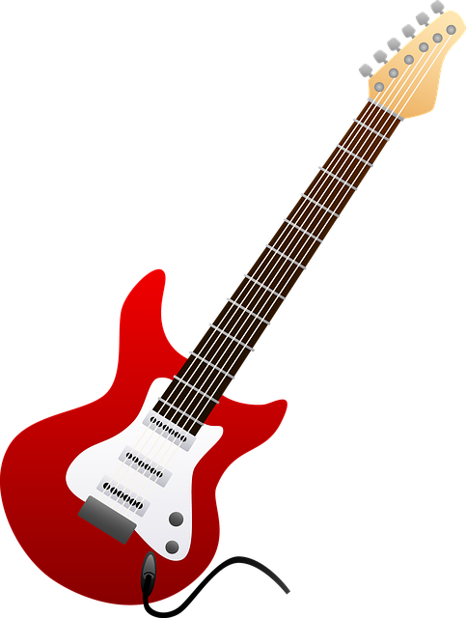
Twin Lakes 2023 Swim Meet Themes!
^{Home Meets}
^{June 22 -Super Heros}
^{June 29 - Cowboy / Western}
^{July 6 - Football}
July 13 - Throwback – y2k/90s/80s/neon
^{B-Champs – Disney}
^{All City – Hard Rock}
* Additional Post Season Themes TBD

Slide 32
Our Website / Registration

Slide 33
Registration
Registration is now OPEN!
Registration will close June 18th.

Slide 34
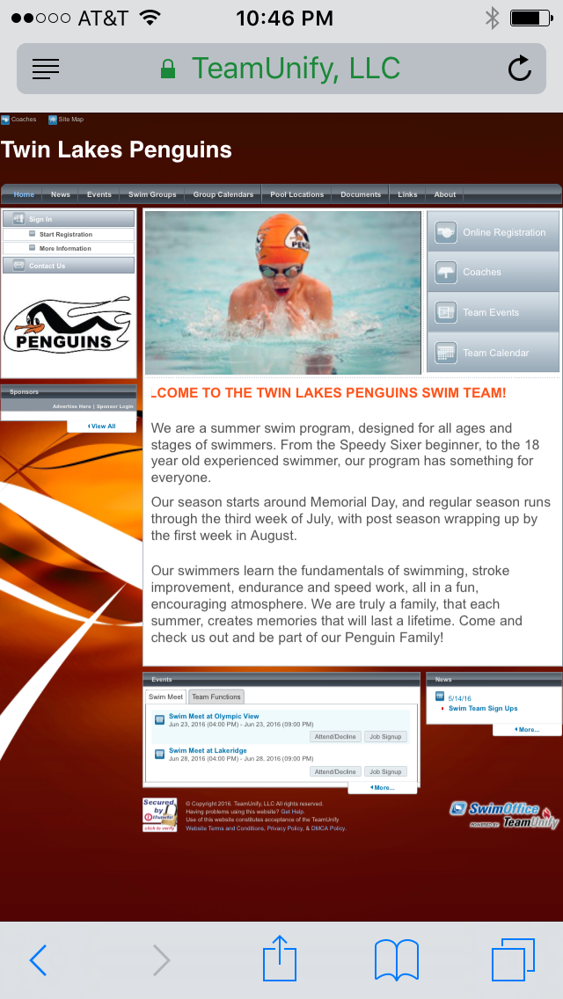
How To Register for Swim Team:
Go to: www.twinlakespenguins.com
With this website we are able to do the following:
Register for the upcoming 2023 swim season
Select the size T-shirt your swimmer needs
Choose which meets you will attend/not attend
Request a stroke you’d like your swimmer to do in each meet
Sign up for volunteer positions for each home meet
Get directions to each of the pools
Check your swimmer’s meet results
Send you emails through the Team Unify website
Communicate reminders and updates and LOTS MORE!

Slide 35
If you are having issues trying to register on the twinlakespenguins.com website
Go to the www.twinlakespenguins.com website
On the main website page, scroll down on click on the
Online Registration on the left side of the page.
Select Add to Cart next to each age group that you wish
to register
After all members added to cart, select My Shopping Cart
in the upper right corner of the page.
Select Check Out Now
If not already signed in, you will now need to either Create an Account
or Log In
Next to each group, you will need to assign a swimmer
If it is a returning swimmer, when the text box with the list of swimmers
is open, you will need to go all the way to the right of their name and
click on the pencil icon
Once your swimmers info is open, you will need to make sure that
something is written in each text box (preferred name, medical etc. ).
The new software does not like any empty text box. You can even just type
None or Nothing
Once swimmer info is edited, you should be able to complete
checkout by following the remaining directions.

Slide 36
Team Communication
We will communicate via email and posting on our Facebook and Instagram pages
You can make sure you get the latest information by:
Verify the email address is valid when you register
Find us on Facebook (Twin Lakes Penguins Swim Team), like the page, and follow us

Slide 37
Where do I get more Information?
Look on our webpage
Tips Tricks and Secrets
Survival Guide
Ask our new Parent welcome Team! For 10 and unders – Leila Carlson, for 11 and over – Lisa Yalcin
Ask! Our veteran parents are always welcoming and eager to help

Slide 38
Water Polo
Huge thank you to Thomas Donovan for kicking off our first ever season of TL water polo. Unfortunately the Donovan's will be traveling this summer, but fear not! We will still be offering water polo this year!
Log into www.twinlakespenguins.com to register for Water Polo! Cost is $50 per swimmer. We are hoping to have our 12 and under team again this year, as well as add a 13 and over group. Water Polo registration is now LIVE!

Slide 39
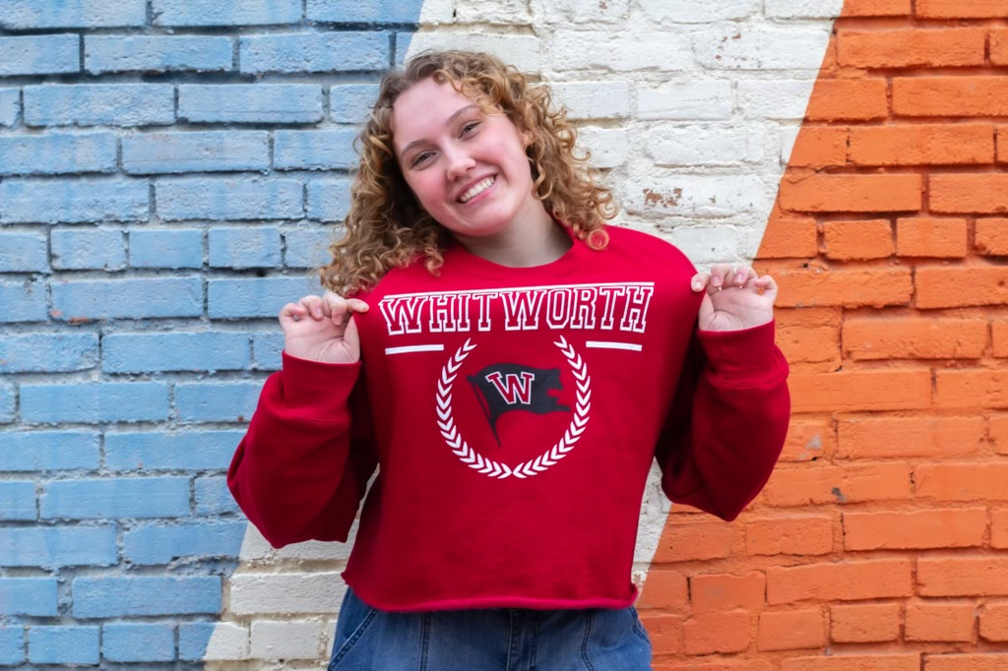
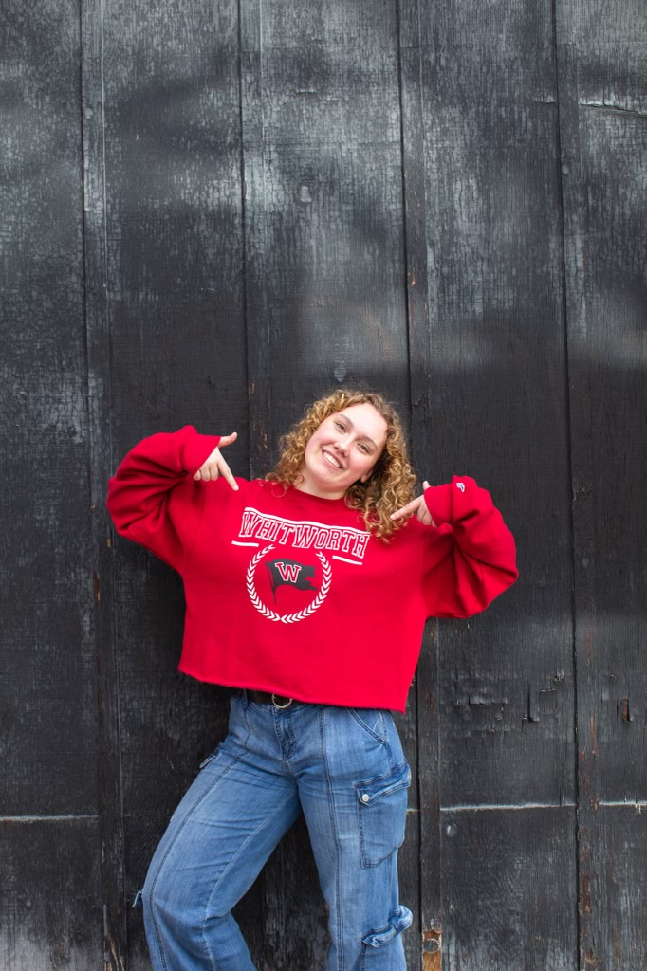
Water Polo Coach Lilly
A little about me, I am just finishing my 2nd year at Colorado Mesa, I swam for the University last year, but this year I entered the transfer portal and took up playing co-ed club water polo. I will be transferring to Whitworth in the fall, continuing my engineering studies, and resuming swimming as a Whitworth Pirate!
Hi Penguins! My name is Lilly, and I am so excited to be your Water Polo coach this year! You may recognize me because I myself was a penguin for 14 years, and I was one of the TL coaches last year. While I am sad that my training schedule won't allow for me to be your swim coach, I am super excited to be able to be your water polo coach!

Slide 40
Sponsorship Opportunities

Slide 41
Platinum Status: $500.00 Donation
Extra-Large sized logo on Twin Lakes banner displayed at pool all season
Signage with your logo displayed on starting blocks for each home meet
Banner displayed in team area at post season championships
Framed Team Picture at end of season
Company name acknowledged by announcer at all home meets
Acknowledgment on our Facebook page with a link to your business
Gold Medal: $300.00 Donation
Large sized logo on Twin Lakes banner displayed at pool all season
Banner displayed in team area at post season championship
Framed Team Picture at end of season
Company name acknowledged by announcer at all home meets
Acknowledgment on our Facebook page
Silver Medal: $200.00 Donation
Medium sized logo on Twin Lakes banner displayed at pool all season
Acknowledgement on our Facebook Page
Bronze Medal: $100.00 Donation
Small sized logo on Twin Lakes Banner displayed at pool all season
Please contact David Goretski goretski@earthlink.net or Charis and Julie if you are interested in being a sponsor, or know someone who is interested! tlstmanager@gmail.com
**TLST is a registered non profit. All donations are tax deductible**
***All sponsorship fees go to support our swim team!!***

Slide 42
Reminders
Go online to register for TL Swim Team: www.twinlakespenguins.com
Get your TL Club membership if you haven’t already done so.
Order your apparel if you want a sweatshirt or parent T-shirt. (Swimmers get a T-shirt with their swim team fee.)
If you didn’t order a swimsuit, go online to www.swimoutlet.com/twinlakespenguins to order!
Anyone you know interested in joining the swim team please have them email us at tlstmanager@gmail.com
Check out the Jr Golf table and learn about our summer Jr Golf program!
QUESTIONS??

Slide 43
4 tickets for
Mariners vs Baltimore
August 13th

Slide 44
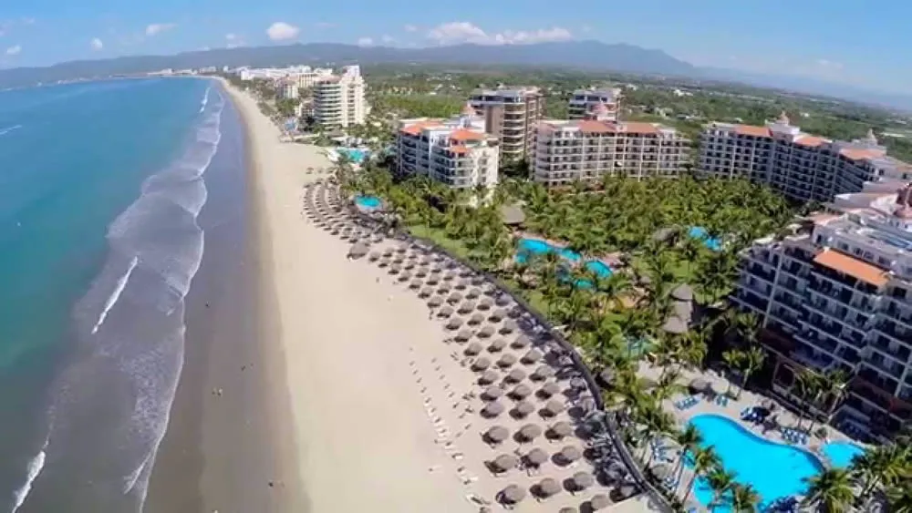
1 week at a resort in Nuevo Vallarta
*Bids starting at $1000

Slide 45
Italian Dinner cooked by Amy Dill
Homemade Spaghetti and Meatballs (secret family recipe)
Italian Sausage links
Crusty Italian Loaf
Caesar Salad
Dessert
Bottle of Red Wine
Value: PRICELESS

Slide 46
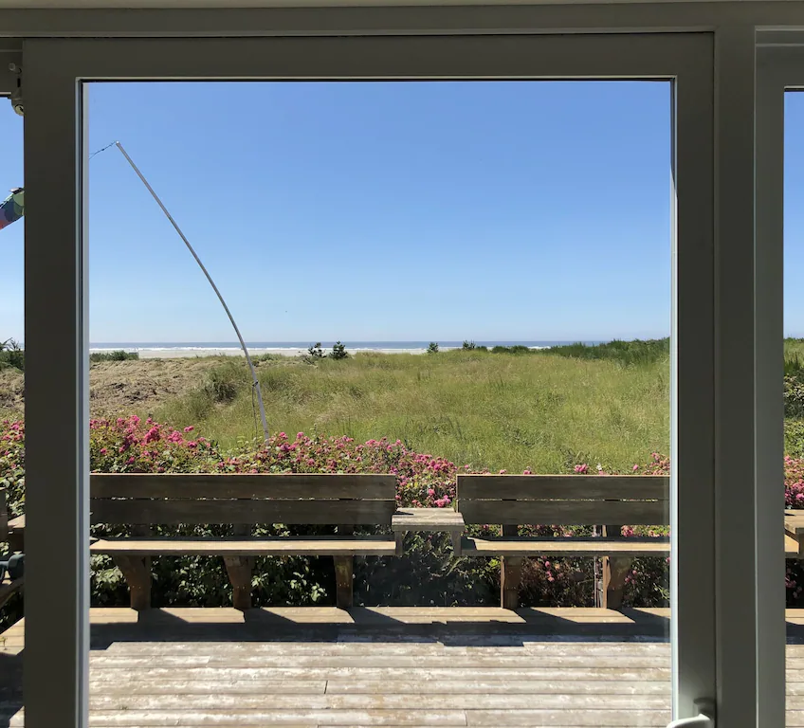
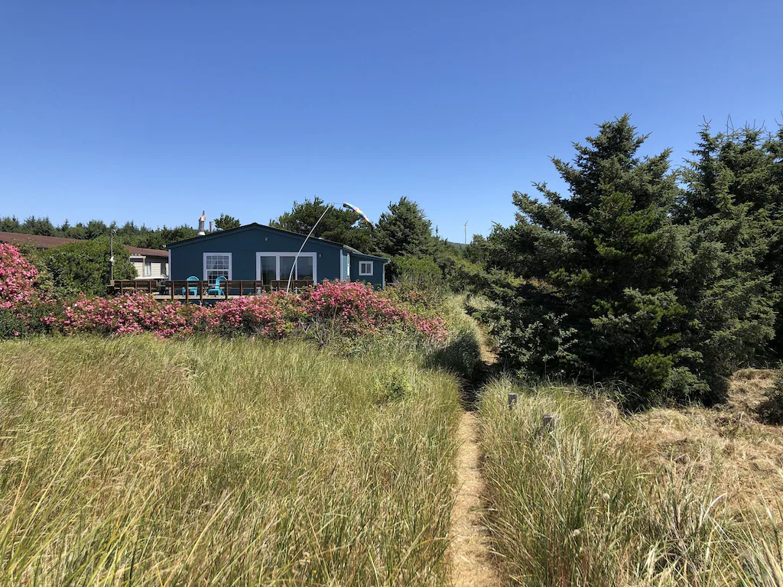
3 days 2 nights at a beach front home in Grayland
Near Westport
https://www.vrbo.com/1499177?unitId=2057922

Slide 47
Reserved Parking for TL vs Olympic View
June 22

Slide 48
Reserved Parking for
TL vs Normandy Park
June 29

Slide 49
Reserved Parking for
TL vs Lakeridge
July 6

Slide 50
Reserved Parking for
TL vs Kent
July 13

Slide 51
Reserved Parking for ALL 4 of the home meets!

